Slide 1


MY PAYPAL
FRAUD DETECTION USING MACHINE LEARNING TECHNIQUES
Presented by: Olajuwon Aina

Slide 2



Project
Background
In this project, a fraud detection model is built using a dataset of European credit card transactions. The primary objectives include precise fraud identification, minimizing false positives, and concurrently increasing revenue.

Slide 3


About the Data
The dataset primarily comprises numerical input variables derived from PCA transformation, except for two features, 'Time' and 'Amount,' which remain untransformed. The 'Time' feature signifies the time interval between transactions, while 'Amount' represents the transaction amount. The 'Class' feature, serving as the response variable, takes the value of 1 for fraudulent transactions and 0 for non-fraudulent ones. To maintain confidentiality, the original features and additional background information about the data cannot be disclosed.

Slide 4


Exploratory Data Analysis
In this section, we performed data visualization to gain insights into the distribution of the features, identify any missing values or outliers, and understand the relationship between the features and the response variable.

Slide 5
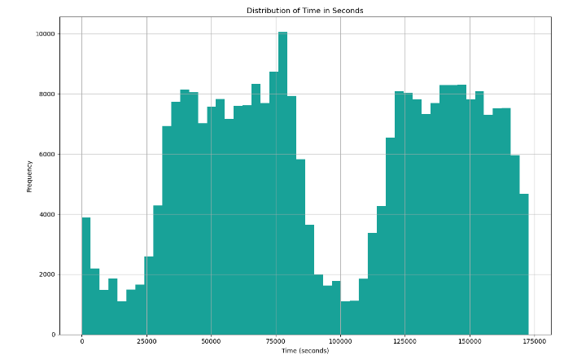
Frequency Distribution of Transaction Time
This histogram illustrates the distribution of transaction times in seconds within the dataset. The data indicates fluctuations in transaction numbers over time, forming a predominantly uniform distribution. Noteworthy spikes signify periods of heightened transaction frequency, while lows indicate intervals of reduced transaction activity.

Slide 6

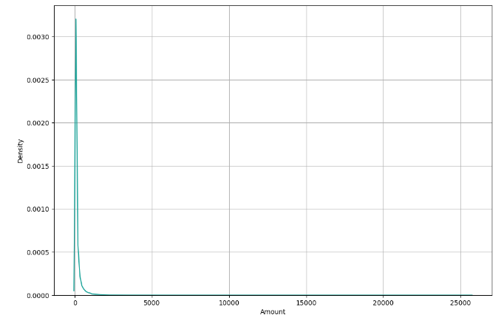
Distribution of Transaction Amounts
The graph displays how often different amounts appear in our data. It's called a Kernel Density Estimation (KDE) plot, a way to estimate the likelihood of different amounts. The graph suggests that most amounts cluster between 0 and 1000, but there are a few transactions with much higher amounts, even reaching 10,000. This might mean that the majority of transactions in our data are for lower amounts.

Slide 7
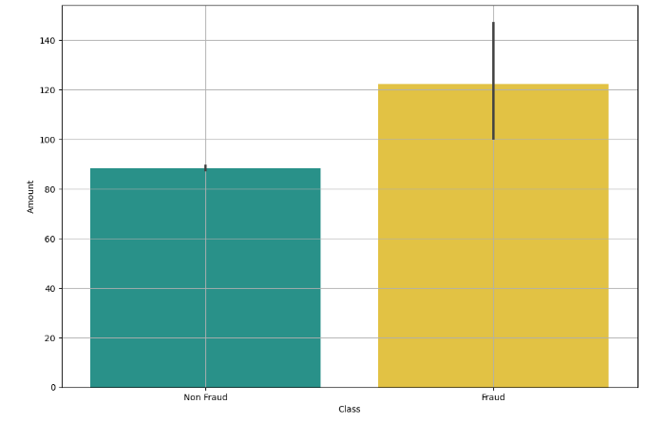
Relationship Between the Class and Amount
We plotted a box plot of the 'Amount' column for each class (fraudulent and non-fraudulent transactions) to check if there was any relationship between the transaction amount and the class. We observed that fraudulent transactions tended to have higher transaction amounts compared to non-fraudulent transactions.

Slide 8

Machine Learning
In this section, we performed data preprocessing and model training to prepare the dataset for machine learning algorithms and build an accurate fraud detection model.

Slide 9

Data Preprocessing:
By Scaling the Data
Here, we prepared the data by changing its form and size so that the model works better and gives us more information.
We used the Standard Scaler to adjust the size of the independent features in the dataset. This method changes the data to have an average of 0 and a standard deviation of 1. This ensures that all the features in the dataset are in a similar range, making the model perform better.

Slide 10
Model Training & Building
In this part, we concentrated on training and testing out the classification model for our project. We looked into different ways of sampling to figure out which one worked the best.
We're going to check out two methods to handle the problem of uneven classes in our data: OVERSAMPLING and SMOTE.
These methods will help us make datasets that have a balance for the Logistic Regression model, and we'll see which one works the best.

Slide 11
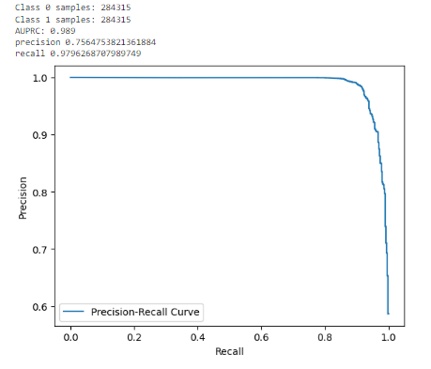
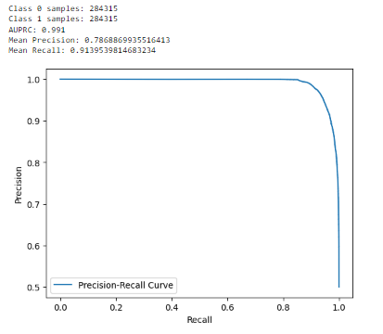
Sampling Methods Used
VS
Oversampling Method
Smote Method

Slide 12
Methods’ Results Summary
The logistic regression model trained using the SMOTE method is the most effective and accurate model in the document. This is because the model achieved an impressive AUPRC score of 0.991, indicating a high level of precision and recall in identifying fraudulent transactions. The SMOTE method was effective in balancing the dataset and improving the classifier's accuracy in identifying fraudulent transactions.
Therefore, the logistic regression model trained using the SMOTE method is the most effective and accurate model for detecting fraudulent transactions in this project.

Slide 13
Conclusion
In this project, we created a smart model to detect fake credit card transactions. First, we looked at the data to see how classes and features were spread out. There was a problem because some types of transactions were not well represented. We tried different methods to fix this, and using SMOTE worked best. We trained our model using logistic regression with SMOTE and checked how well it did using the AUPRC score, which was really good at 0.991. So, we've made a reliable model that can find fraudulent transactions accurately, and it could be useful in the real world.

